Slide 1

Diseño de una FSM para una maquina de venta de gaseosas
Mauricio Ramirez Ramirez 0611167

Slide 2
Especificaciones de diseño
La maquina recibe monedas de 100 y 200 pesos.
Entrega productos: Coca-cola y Postobon = 700 pesos.
La maquina no entrega devuelta.
Diagrama de estados.
FSM tipo Moore.
Utilizar Flip-Flop tipo D.

Slide 3
Codificación de entradas y salidas
ENTRADA |  | SALIDA
00 | $100 | 00 | No entregar
01 | $200 | 01 | Coca-cola
10 | Coca-cola | 10 | Postobon
11 | Postobon | ---- | -----

Slide 4










Diagrama de estados
01
10
11
01
10
11
01
10
11
10
11
00
00
00
00
00
10
11
01
01
10
11
00
10
11
01
01
00
10
00
01
10
11
00
01
11
00
01

Slide 5
Tabla de estados
IN |  | EP |  |  |  | PE |  |  |  | Z
a | b | Q3 | Q2 | Q1 | Q0 | Q3* | Q2* | Q1* | Q0*
0 | 0 | 0 | 0 | 0 | 0 | 0 | 0 | 0 | 1 | 0 | 0
0 | 0 | 0 | 0 | 0 | 1 | 0 | 0 | 1 | 0 | 0 | 0
0 | 0 | 0 | 0 | 1 | 0 | 0 | 0 | 1 | 1 | 0 | 0
0 | 0 | 0 | 0 | 1 | 1 | 0 | 1 | 0 | 0 | 0 | 0
0 | 0 | 0 | 1 | 0 | 0 | 0 | 1 | 0 | 1 | 0 | 0
0 | 0 | 0 | 1 | 0 | 1 | 0 | 1 | 1 | 0 | 0 | 0
0 | 0 | 0 | 1 | 1 | 0 | 0 | 1 | 1 | 1 | 0 | 0
0 | 0 | 0 | 1 | 1 | 1 | 0 | 1 | 1 | 1 | 0 | 0
0 | 0 | 1 | 0 | 0 | 0 | 0 | 0 | 0 | 1 | 0 | 0
0 | 0 | 1 | 0 | 0 | 1 | 0 | 0 | 0 | 1 | 0 | 0
0 | 0 | 1 | 0 | 1 | 0 | X | X | X | X | X | X
0 | 0 | 1 | 0 | 1 | 1 | X | X | X | X | X | X
0 | 0 | 1 | 1 | 0 | 0 | X | X | X | X | X | X
0 | 0 | 1 | 1 | 0 | 1 | X | X | X | X | X | X
0 | 0 | 1 | 1 | 1 | 0 | X | X | X | X | X | X
0 | 0 | 1 | 1 | 1 | 1 | X | X | X | X | X | X
IN |  | EP |  |  |  | PE |  |  |  | Z
a | b | Q3 | Q2 | Q1 | Q0 | Q3* | Q2* | Q1* | Q0*
0 | 1 | 0 | 0 | 0 | 0 | 0 | 0 | 1 | 0 | 0 | 0
0 | 1 | 0 | 0 | 0 | 1 | 0 | 0 | 1 | 1 | 0 | 0
0 | 1 | 0 | 0 | 1 | 0 | 0 | 1 | 0 | 0 | 0 | 0
0 | 1 | 0 | 0 | 1 | 1 | 0 | 1 | 0 | 1 | 0 | 0
0 | 1 | 0 | 1 | 0 | 0 | 0 | 1 | 1 | 0 | 0 | 0
0 | 1 | 0 | 1 | 0 | 1 | 0 | 1 | 1 | 1 | 0 | 0
0 | 1 | 0 | 1 | 1 | 0 | 0 | 1 | 1 | 1 | 0 | 0
0 | 1 | 0 | 1 | 1 | 1 | 0 | 1 | 1 | 1 | 0 | 0
0 | 1 | 1 | 0 | 0 | 0 | 0 | 0 | 1 | 0 | 0 | 0
0 | 1 | 1 | 0 | 0 | 1 | 0 | 0 | 1 | 0 | 0 | 0
0 | 1 | 1 | 0 | 1 | 0 | X | X | X | X | X | X
0 | 1 | 1 | 0 | 1 | 1 | X | X | X | X | X | X
0 | 1 | 1 | 1 | 0 | 0 | X | X | X | X | X | X
0 | 1 | 1 | 1 | 0 | 1 | X | X | X | X | X | X
0 | 1 | 1 | 1 | 1 | 0 | X | X | X | X | X | X
0 | 1 | 1 | 1 | 1 | 1 | X | X | X | X | X | X

Slide 6
Tabla de estados
IN |  | EP |  |  |  | PE |  |  |  | Z
a | b | Q3 | Q2 | Q1 | Q0 | Q3* | Q2* | Q1* | Q0*
1 | 0 | 0 | 0 | 0 | 0 | 0 | 0 | 0 | 0 | 0 | 0
1 | 0 | 0 | 0 | 0 | 1 | 0 | 0 | 0 | 1 | 0 | 0
1 | 0 | 0 | 0 | 1 | 0 | 0 | 0 | 1 | 0 | 0 | 0
1 | 0 | 0 | 0 | 1 | 1 | 0 | 0 | 1 | 1 | 0 | 0
1 | 0 | 0 | 1 | 0 | 0 | 0 | 1 | 0 | 0 | 0 | 0
1 | 0 | 0 | 1 | 0 | 1 | 0 | 1 | 0 | 1 | 0 | 0
1 | 0 | 0 | 1 | 1 | 0 | 0 | 1 | 1 | 0 | 0 | 0
1 | 0 | 0 | 1 | 1 | 1 | 1 | 0 | 0 | 0 | 0 | 1
1 | 0 | 1 | 0 | 0 | 0 | 0 | 0 | 0 | 0 | 0 | 0
1 | 0 | 1 | 0 | 0 | 1 | 0 | 0 | 0 | 0 | 0 | 0
1 | 0 | 1 | 0 | 1 | 0 | X | X | X | X | X | X
1 | 0 | 1 | 0 | 1 | 1 | X | X | X | X | X | X
1 | 0 | 1 | 1 | 0 | 0 | X | X | X | X | X | X
1 | 0 | 1 | 1 | 0 | 1 | X | X | X | X | X | X
1 | 0 | 1 | 1 | 1 | 0 | X | X | X | X | X | X
1 | 0 | 1 | 1 | 1 | 1 | X | X | X | X | X | X
IN |  | EP |  |  |  | PE |  |  |  | Z
a | b | Q3 | Q2 | Q1 | Q0 | Q3* | Q2* | Q1* | Q0*
1 | 1 | 0 | 0 | 0 | 0 | 0 | 0 | 0 | 0 | 0 | 0
1 | 1 | 0 | 0 | 0 | 1 | 0 | 0 | 0 | 1 | 0 | 0
1 | 1 | 0 | 0 | 1 | 0 | 0 | 0 | 1 | 0 | 0 | 0
1 | 1 | 0 | 0 | 1 | 1 | 0 | 0 | 1 | 1 | 0 | 0
1 | 1 | 0 | 1 | 0 | 0 | 0 | 1 | 0 | 0 | 0 | 0
1 | 1 | 0 | 1 | 0 | 1 | 0 | 1 | 0 | 1 | 0 | 0
1 | 1 | 0 | 1 | 1 | 0 | 0 | 1 | 1 | 0 | 0 | 0
1 | 1 | 0 | 1 | 1 | 1 | 1 | 0 | 0 | 1 | 1 | 0
1 | 1 | 1 | 0 | 0 | 0 | 0 | 0 | 0 | 0 | 0 | 0
1 | 1 | 1 | 0 | 0 | 1 | 0 | 0 | 0 | 0 | 0 | 0
1 | 1 | 1 | 0 | 1 | 0 | X | X | X | X | X | X
1 | 1 | 1 | 0 | 1 | 1 | X | X | X | X | X | X
1 | 1 | 1 | 1 | 0 | 0 | X | X | X | X | X | X
1 | 1 | 1 | 1 | 0 | 1 | X | X | X | X | X | X
1 | 1 | 1 | 1 | 1 | 0 | X | X | X | X | X | X
1 | 1 | 1 | 1 | 1 | 1 | X | X | X | X | X | X

Slide 7

Mapas de karnaugh
Q3Q2
IN[00]
Q3Q2
IN[01]
Para D3
Q1Q0
Q1Q0
 |  | X
 |  | X
 |  | X | X
 |  | X | X
 |  | X
 |  | X
 |  | X | X
 |  | X | X
Q3Q2
IN[10]
Q3Q2
IN[11]
Q1Q0
Q1Q0
 |  | X
 |  | X
 | 1 | X | X
 |  | X | X
 |  | X
 |  | X
 | 1 | X | X
 |  | X | X

Slide 8
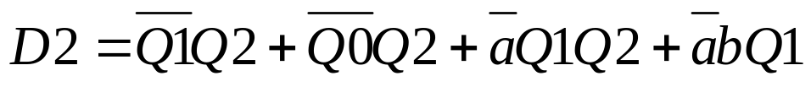
Mapas de karnaugh
Q3Q2
IN[00]
Q3Q2
IN[01]
Para D2
Q1Q0
Q1Q0
 | 1 | X
 | 1 | X
1 | 1 | X | X
 | 1 | X | X
 | 1 | X
 | 1 | X
1 | 1 | X | X
1 | 1 | X | X
Q3Q2
IN[10]
Q3Q2
IN[11]
Q1Q0
Q1Q0
 | 1 | X
 | 1 | X
 |  | X | X
 | 1 | X | X
 | 1 | X
 | 1 | X
 |  | X
 | 1 | X | X

Slide 9
Mapas de karnaugh
Q3Q2
IN[00]
Q3Q2
IN[01]
Para D1
Q1Q0
Q1Q0
 |  | X
1 | 1 | X
 | 1 | X | X
1 | 1 | X | X
1 | 1 | X | 1
1 | 1 | X | 1
 | 1 | X | X
 | 1 | X | X
Q3Q2
IN[10]
Q3Q2
IN[11]
Q1Q0
Q1Q0
 |  | X
 |  | X
1 |  | X | X
1 | 1 | X | X
 |  | X
 |  | X
1 |  | X | X
1 | 1 | X | X

Slide 10
Mapas de karnaugh
Q3Q2
IN[00]
Q3Q2
IN[01]
Para D0
Q1Q0
Q1Q0
1 | 1 | X | 1
 |  | X | 1
 | 1 | X | X
1 | 1 | X | X
 |  | X
1 | 1 | X
1 | 1 | X | X
 | 1 | X | X
Q3Q2
IN[10]
Q3Q2
IN[11]
Q1Q0
Q1Q0
 |  | X
1 | 1 | X
1 |  | X | X
 |  | X | X
 |  | X
1 | 1 | X
1 | 1 | X | X
 |  | X | X

Slide 11

Mapas de karnaugh
Q3Q2
IN[00]
Q3Q2
IN[01]
Para Z1
Q1Q0
Q1Q0
 |  | X
 |  | X
 |  | X | X
 |  | X | X
 |  | X
 |  | X
 |  | X | X
 |  | X | X
Q3Q2
IN[10]
Q3Q2
IN[11]
Q1Q0
Q1Q0
 |  | X
 |  | X
 |  | X | X
 |  | X | X
 |  | X
 |  | X
 | 1 | X | X
 |  | X | X

Slide 12
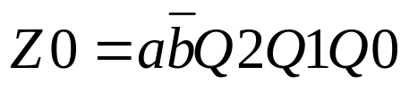
Mapas de karnaugh
Q3Q2
IN[00]
Q3Q2
IN[01]
Para Z0
Q1Q0
Q1Q0
 |  | X
 |  | X
 |  | X | X
 |  | X | X
 |  | X
 |  | X
 |  | X | X
 |  | X | X
Q3Q2
IN[10]
Q3Q2
IN[11]
Q1Q0
Q1Q0
 |  | X
 |  | X
 | 1 | X | X
 |  | X | X
 |  | X
 |  | X
 |  | X | X
 |  | X | X

Slide 13
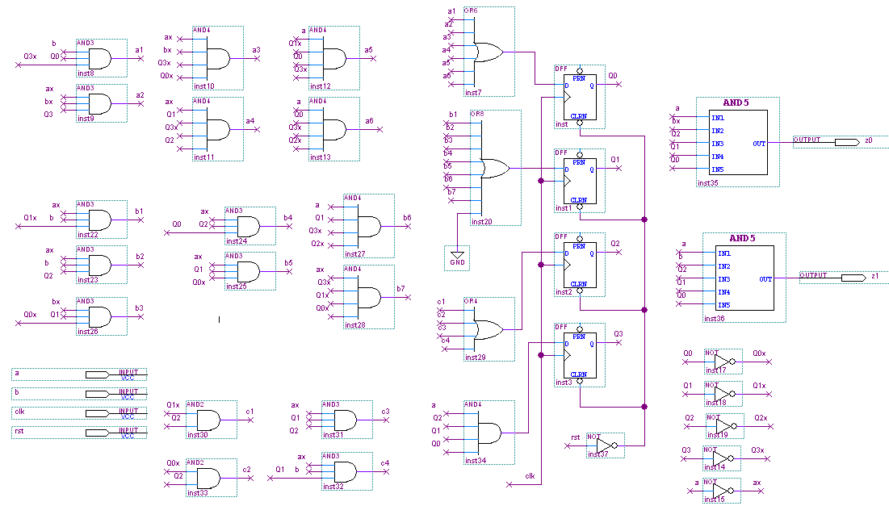
Implementación de la lógica

Slide 14

Simulación
Se insertaran varias monedas de diferente valor, obteniendo un valor de saldo mayor o igual a $700, y se procederá a solicitar el producto, observando si la salida corresponde al producto deseado, teniendo en cuenta la codificación de entradas y salidas usada.
Se inserta una moneda de $200 y varias de $100, obteniendo un valor mucho mayor a $700
Se entrega producto
Se solicita producto

Slide 15

Simulación
Ahora se insertara una moneda de $200 y una de $100, y se procederá a solicitar el producto, observando si la salida corresponde al producto deseado.
El valor acumulado es inferior a $700
No se entrega producto

Slide 16
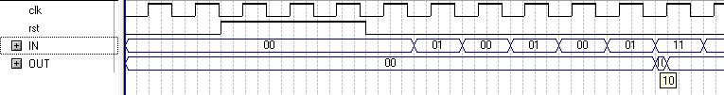
Simulación
Por ultimo se insertaran varias monedas y se procederá a solicitar el otro producto, observando si la salida corresponde al producto deseado.
El valor acumulado es mayor a $700
Se entrega el producto solicitado

